Slide 1

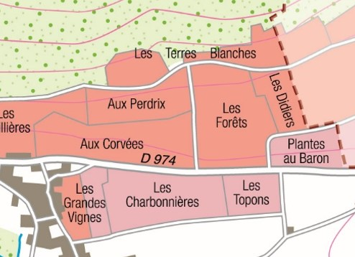
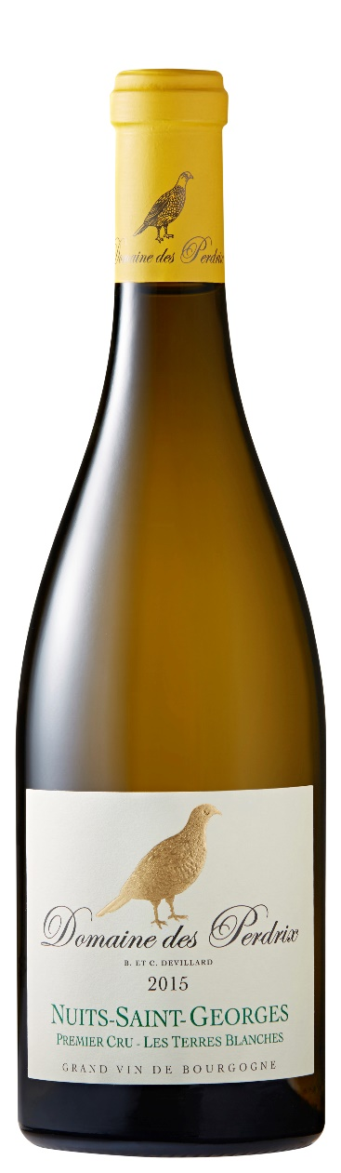
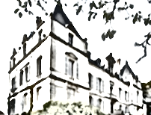
NUITS-SAINT-GEORGES
PREMIER CRU LES TERRES BLANCHES
2021
TERROIR
Our vineyard Les Terres Blanches is located above Premier Cru Aux Perdrix.
Total area : 0,33 hectares (0,7986 acres) 2 plots planted in 1954 and in 1997.
Climat & Soil : South-East facing vines established on a gentle slope in South of Nuits-Saint-Georges. The soil is a mix of limestone and clay with clay predominance.
TASTING NOTES
EYE
Bright color with golden tints.
NOSE
The nose is generous, with a bouquet of lemony citrus, lily-of-the-valley flowers and lilac, supported by a hint of minerality.
PALATE
Full-bodied, fruity and fresh on the palate.
The finish lingers on fresh lime notes.
WINEMAKING
To preserve their integrity, grapes are carefully harvested and sorted out by hand.
Following the pneumatic press, juices stay in a vat overnight for a cool settling down and then are directly filled in barrels by gravity.
Alcoholic and malolactic fermentations take place in barrels.
AGING
Aging process is taking place 100% in traditional Burgundian 228 litres barrels during 13 months
We only use light toasted French oak coming mainly from Bourgogne, Allier and Vosges forests.
Then, the wine spends 3 months in tanks.
Light filtration before bottling.
SERVICE & CELLARING
It can be served at 13-14°C.
To be kept in cellar for 5 to 10 years.
FOOD & WINE PAIRINGS
Our Premier Cru Les Terres Blanches blanc 2021 will be a perfect accompaniment to pike-perch fillet, truffled white pudding with homemade mashed potatoes, or prawn ravioli.
Domaine des Perdrix
21700 Nuits-Saint-Georges
Tél : +33 (0)3 85 45 86 55
contact@domaines-devillard.com
www.domainedesperdrix.com

